Slide 1
Session 2
Module 3: Layout Managers
Module 4: Swing Menu Components

Slide 2
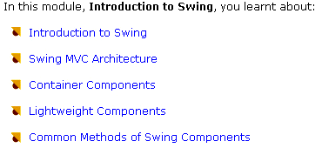
Module 1 Review

Slide 3
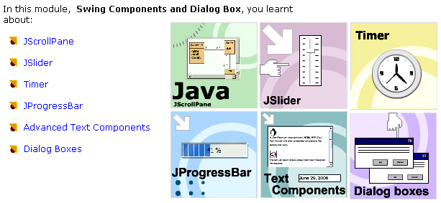
Module 2 Review

Slide 4
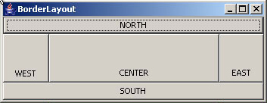

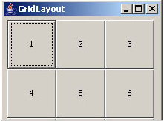

Module 3: Layout Managers
Objectives
Package
java.awt

Slide 5

Setting a Layout to a Container
container.setLayout ( LayoutObject );
container.setSize (width,height);
// or container.pack();
container.setVisible(true);

Slide 6
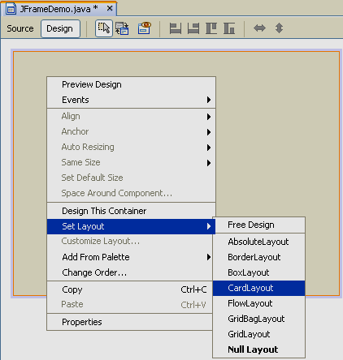
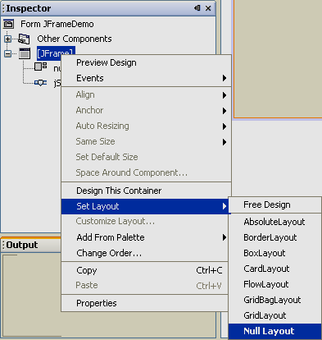
Setting a Layout to a Container in NetBeans

Slide 7
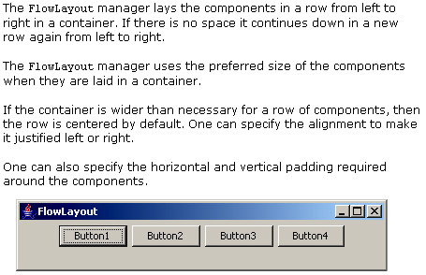
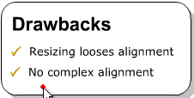
FlowLayout
FlowLayout is default
layout of Jpanel
FlowLayout() Constructs a new FlowLayout with a centered alignment and a default 5-unit horizontal and vertical gap.
FlowLayout(int align) Constructs a new FlowLayout with the specified alignment and a default 5-unit horizontal and vertical gap.
FlowLayout(int align, int hgap, int vgap) Creates a new FlowLayout manager with the indicated alignment and the indicated horizontal and vertical gaps.

Slide 8
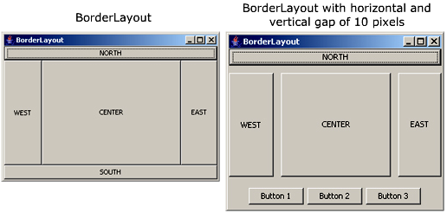
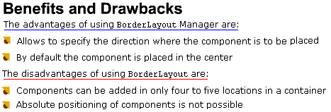
BorderLayout
BorderLayout is default
layout of JFrame, JApplet
BorderLayout() Constructs a new border layout with no gaps between components.
BorderLayout(int hgap, int vgap) Constructs a border layout with the specified gaps between components.
container.add( component com,
int position)
frame.add(btnNorth, BorderLayout.NORTH);

Slide 9
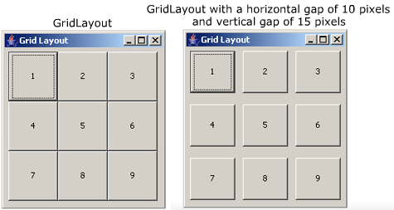

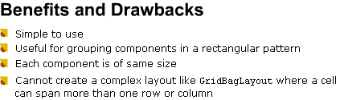
GridLayout
JPanel p= new JPanel();
GridLayout g= new GridLayout(2,2);
p.setLayout(g);
p.add(btn1);
p.add(btn2);
p.add(btn3);
p.add(btn4);

Slide 10
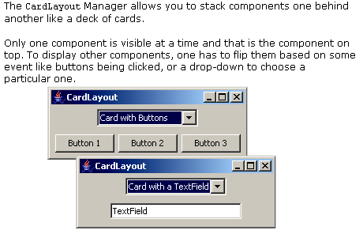

CardLayout
Panel_Main
Panel_1
Panel_2
CardLayout
Advantage:
Allows several containers and their
associated components to share the
same space in the container
Disadvantages
Not visual appealing as a tabbed pane
Requires other components like
buttons or drop-down to plip through.
Panel_3
Control:
next() previous()
first() last()
show()

Slide 11
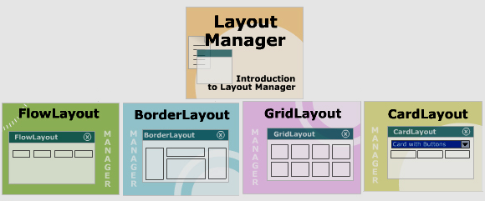
Module 3 Summary

Slide 12
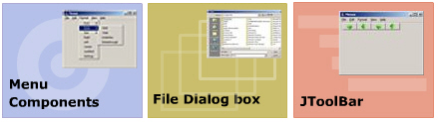
Module 4: Swing Menu Components
Objectives

Slide 13
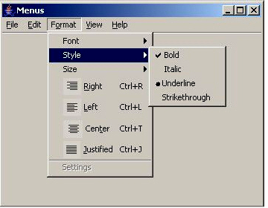
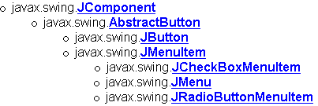
Menu Components
JMenuBar
JMenu
JCheckBoxMenuItem
JRadioButtonMenuItem
icon
JMenuItem
text
JSeparator
mnemonic

Slide 14
JMenuBar class
// Create a JFrame
JFrame f= new JFrame(“Menu demo”);
// Create a JMenuBar
JMenuBar mnuBar = new JMenuBar();
// set menu bar to the frame
f.setJMenuBar(mnuBar);

Slide 15
JMenu class
Constructors:
JMenu()
JMenu(String label)
// create a menu bar
JMenuBar mnuBar= new JMenuBar();
// create a JMenu
JMenu mnuFile= new JMenu(“File”);
// add a menu to menu bar
mnuBar.add(mnuFile);
// add a separator to menu
mnuFile.addSeparator();
// set mnemonic : Alt + F
mnuFile.setMnemonic(KyEvent.VK_F);

Slide 16
JMenuItem class
Constructors:
  JMenuItem()
  JMenuItem(Action a)
  JMenuItem(Icon icon)
  JMenuItem(String text)
  JMenuItem(String text, Icon icon)
  JMenuItem(String text, int mnemonic)
Important methods
  setEnable(boolean enable)
  setMnemonic ( int mnemonic)
  setAccelerator(KeyStroke keyStroke)
Add menu item to menu
menuObject.add(menuItemObject)
Event handling
  ActionEvent
  ActionListener
  public void actionPerformed(ActionEvent evt)

Slide 17
JCheckBoxMenuItem class
Constructors:
  JCheckBoxMenuItem()
  JCheckBoxMenuItem(Action a)
  JCheckBoxMenuItem(String text)
  JCheckBoxMenuItem(Icon icon)
  JCheckBoxMenuItem(String text, Icon icon)
  JCheckBoxMenuItem(String text, boolean b)
  JCheckBoxMenuItem(String text, Icon icon, boolean b)
Important methods
  boolean isSelected()
  get/ setSelected (boolean)
  get/setState(boolean)
Add menu item to menu
menuObject.add(checkBoxMenuItemObject)
Event handling
  ItemEvent
  ItemListener
  public void itemStateChanged(ItemEvent evt)

Slide 18
JRadioButtonMenuItem
To control the selected
state of a group of radio
button menu items,
use a ButtonGroup
object
Constructors:
  JRadioButtonMenuItem()
  JRadioButtonMenuItem(Action a)
  JRadioButtonMenuItem(String text)
  JRadioButtonMenuItem(Icon icon)
  JRadioButtonMenuItem(Icon icon, boolean selected)
  JRadioButtonMenuItem(String text)
  JRadioButtonMenuItem(String text, boolean selected)
  JRadioButtonMenuItem(String text, Icon icon, boolean selected)
Important methods
  boolean isSelected()
  get/setSelected (boolean)
Add menu item to menu
menuObject.add(radioMenuItemObject)
Event handling
  ActionEvent
  ActionListener
  public void actionPerformed (ActionEvent evt)

Slide 19


JPopupMenu class
Constructors:
JPopupMenu()
JPopupMenu(String label)
Common methods:

Slide 20
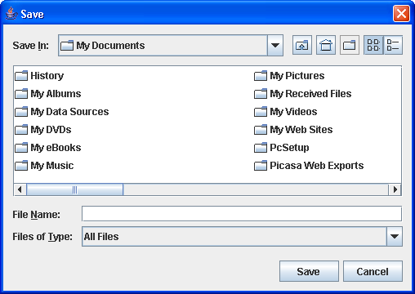



JFileChooser Dialog box
Constructors:
JFileChooser()
JFileChooser(String curDir)

Slide 21
JFileChooser Dialog box …
Controlling on File dialog box:
  File getSelectedFile()
  File getCurrentDirectory()
  setFileFilter (FileFilter obj)
Create a Filter:
public class ImageFilter extends javax.swing.filechooser.FileFilter
{ // override: boolean accept (File)
// override: String getDescription()
}

Slide 22
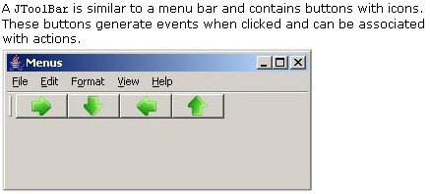
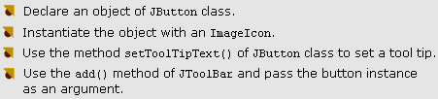
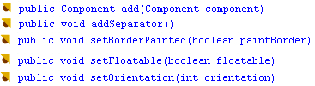
JToolBar class
Constructors:
JToolBar()
JToolBar (int orientation)
JToolBar (String title)
JToolBar (String title, int orientation )
Dockable?
Adding a button to toolbar
Methods

Slide 23
Module 4 Summary

